Slide 1
What is an execution plan?
When you submit a query to SQL server no matter how simple or complex, SQL Server generates an execution plan for that query.
The execution plan shows you how SQL Server breaks down each query submitted by showing you a graphical representation using operators.
There are 3 ways that an execution plan can be viewed:
  1. If you select the Actual Execution Plan option, then the plan is created after execution of the query
  2. If you select the Estimated Execution Plan then the plan is created without executing the query
  3. If you select the Live Query Statistics (SQL 2016 only) then you can view a live the execution plan of an active query without waiting for it to complete
You can view the Execution plans can be presented in three ways:
  Graphical Plans
  Text Plans
  XML Plans
  How does the execution plan select the most efficient plan to execute? It use the query optimizer!

Slide 2
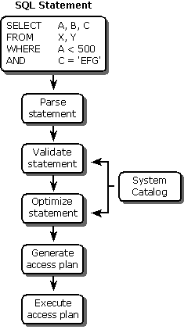
What is the query optimizer?
A query optimizer is part of the SQL Server engine that (SQL) queries and determines the most efficient execution plan.
It does this by optimizing each SQL statement based on statistics collected about the accessed data.
The query optimizer then chooses the most efficient means of executing a SQL statement.
The following diagram shows the steps the query optimizer uses create the execution plan:

